Slide 1
Machine Learning With Python Video 17
Support Vector Regression

Slide 2
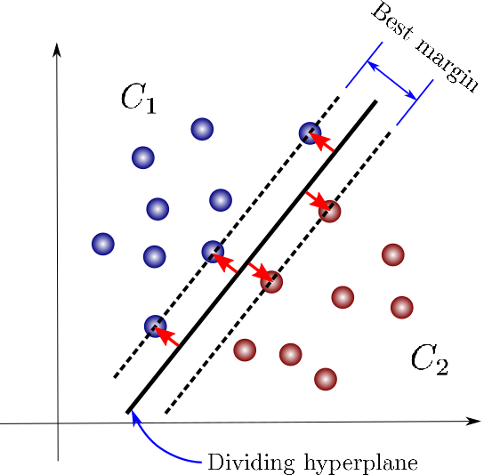
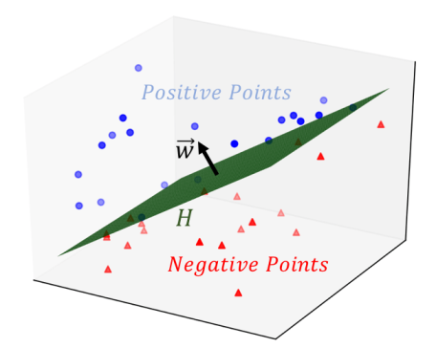
What is Support Vector Machine
The objective of the support vector machine
algorithm is to find a hyperplane in an N
dimensional space(N — the number of features)
That distinctly classifies the data points.

Slide 3
